Slide 1
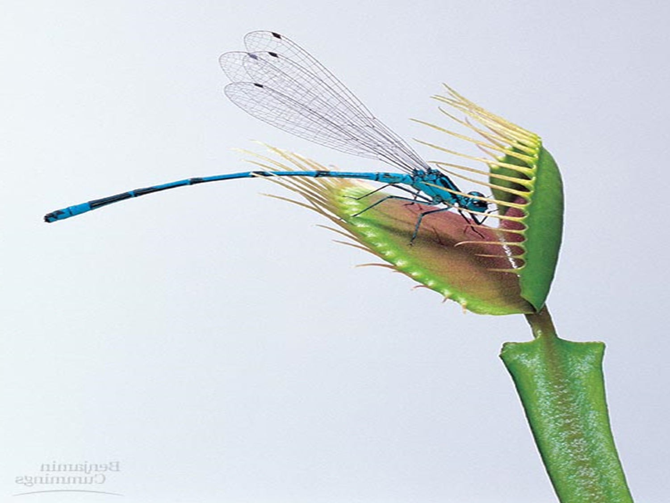
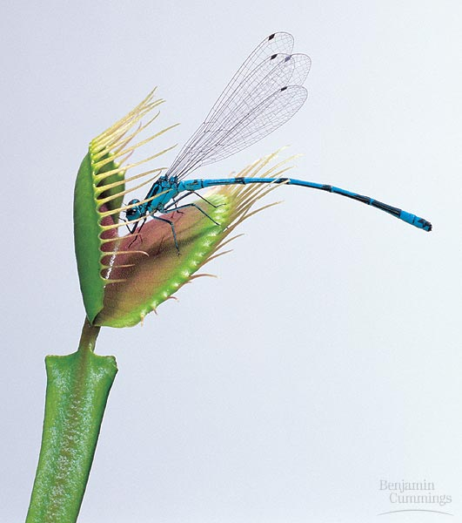
生理學 2020
肌肉系統和肌肉運動
Fang Tung Jing MD, MS, PhD, PhD.

Slide 2
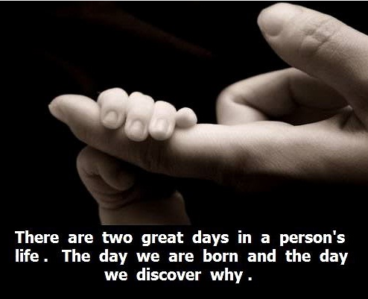
For You
健康源自簡單及善良
房同經
醫學博士MD
理學碩士MS(生理及生物物理學)
哲學博士PhD(細胞生理學)
工學博士PhD(醫工材料學)
當職
教育部部定教職及碩博士導師(1989~)
科技部醫工計畫主持人(~2020)
台北榮民總醫院內科部特聘主治醫師
國防醫學中心三軍總醫院內科部心臟內科
國防醫學院醫學系,生理學科及醫科所
國立陽明大學醫學院醫學系
國立台北科技大學電資學院(及MIT合作實
驗室)和通識中心
國立台灣科技大學醫工研究所及應用科學
研究所
國立台北護理健康大學護理學院

Slide 3

To my teachers
For inspiring me
To my students
For constantly challenging me
To my family
For unconditional support me
For your support, caring and love
During these challenging years
And always.

Slide 4
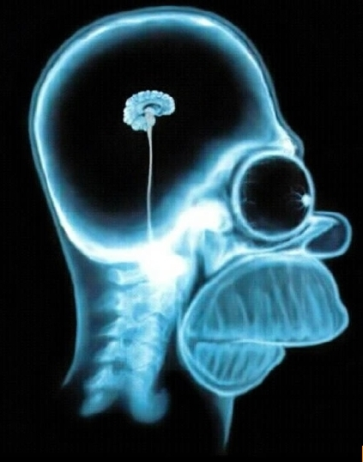
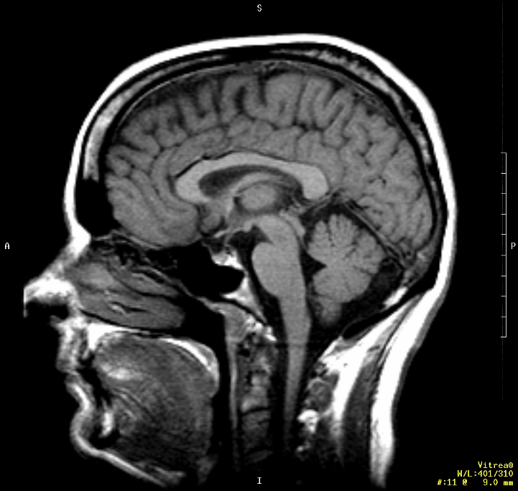
Learning at the University Level
We are shaped by our experiences
We don’t just learn with our brain, but also with our intuition and heart.

Slide 5

Play運用冒險
Passion發揮熱情
Purpose懷有抱負
Communication
Critical thinking
Collaboration
Creativity
不該浪費時間害怕，
恐懼讓人白白浪費時間。

Slide 6


至少，我們是不是能夠…？
是所有進展的開始。

Slide 7
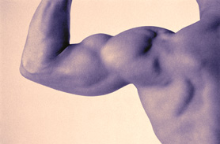
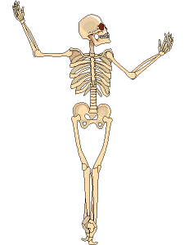
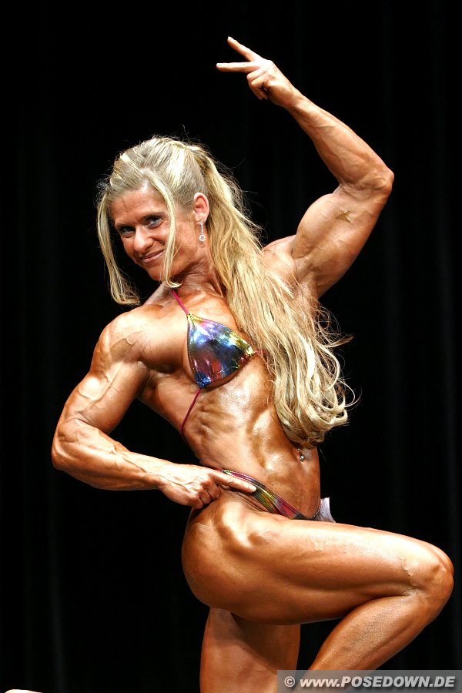
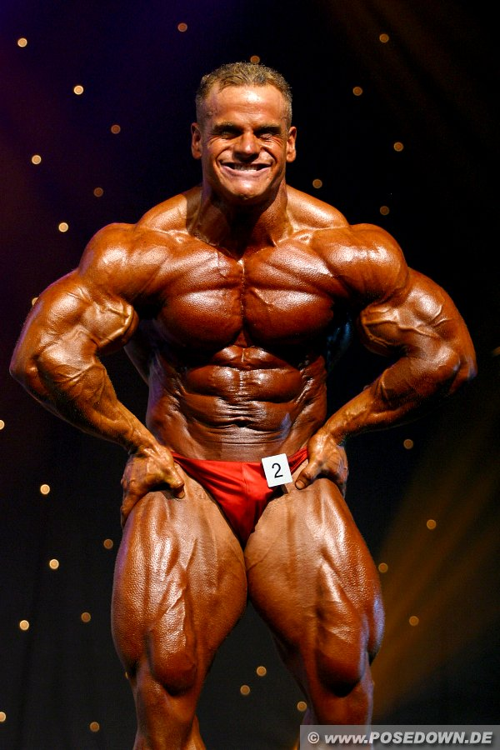
Muscle Contraction

Slide 8
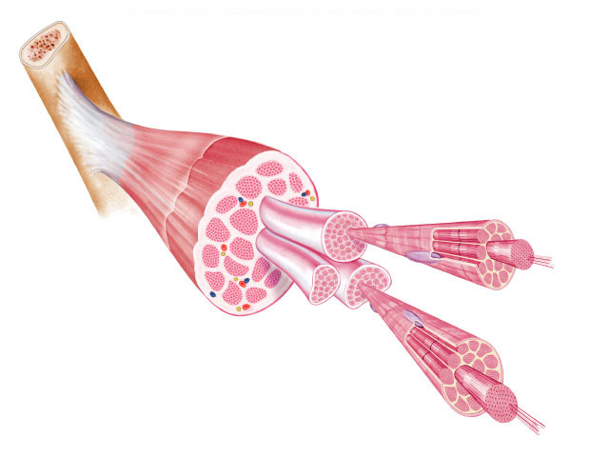
Organization of Skeletal muscle
skeletal muscle
plasma
membrane
nuclei
tendon
muscle fiber (cell)
myofibrils
myofilaments

Slide 9
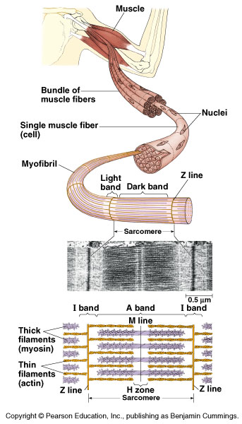
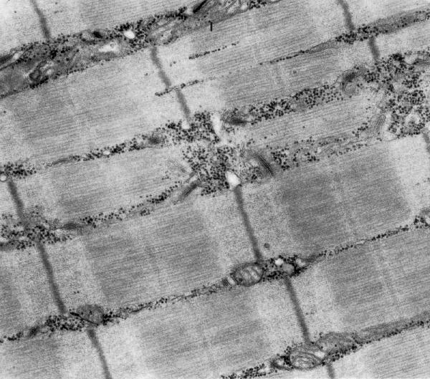
Structure of striated skeletal muscle
Muscle Fiber
muscle cell
divided into sections = sarcomeres
Sarcomere
functional unit of muscle contraction
alternating bands of thin (actin) & thick (myosin) protein filaments

Slide 10
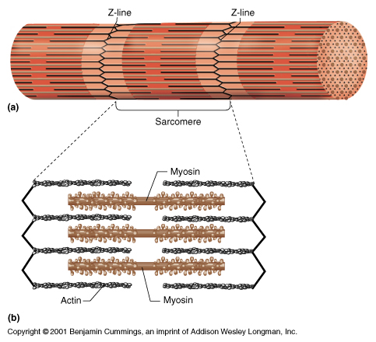
Muscle filaments & Sarcomere
Interacting proteins
thin filaments
braided strands
actin
tropomyosin
troponin
thick filaments
myosin

Slide 11
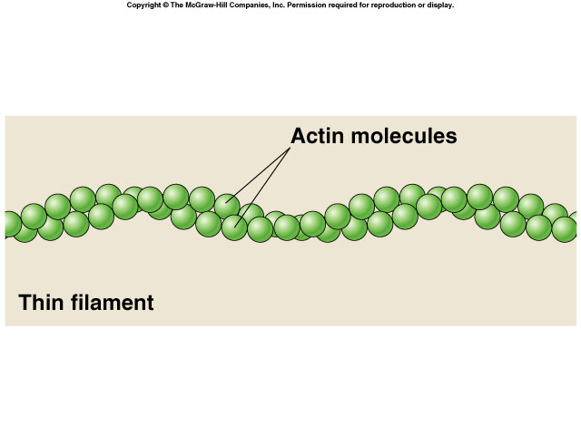
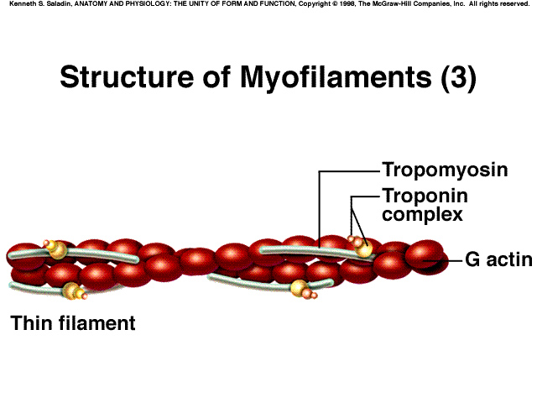
Thin filaments: actin
Complex of proteins
braid of actin molecules & tropomyosin fibers
tropomyosin fibers secured with troponin molecules

Slide 12
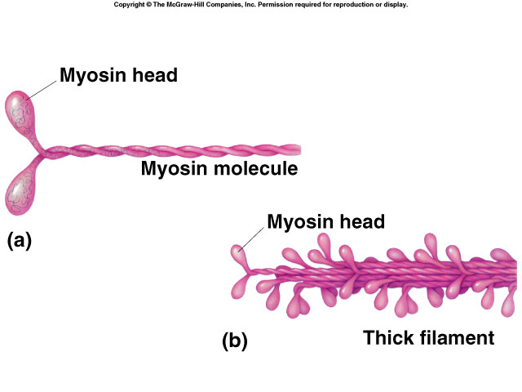
Thick filaments: myosin
Single protein
myosin molecule
long protein with globular head
bundle of myosin proteins:
globular heads aligned

Slide 13
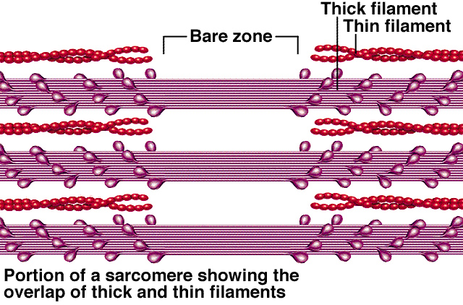
Thick & thin filaments
Myosin tails aligned together & heads pointed away from center of sarcomere

Slide 14
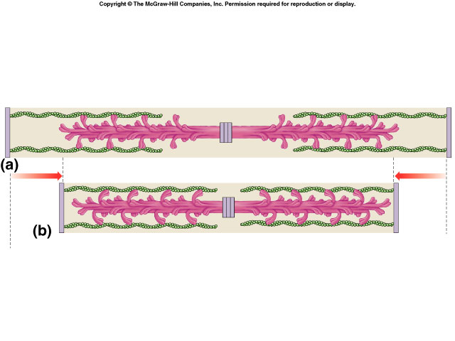
Interaction of thick & thin filaments
Cross bridges
connections formed between myosin heads (thick filaments) & actin (thin filaments)
cause the muscle to shorten (contract)
sarcomere
sarcomere

Slide 15
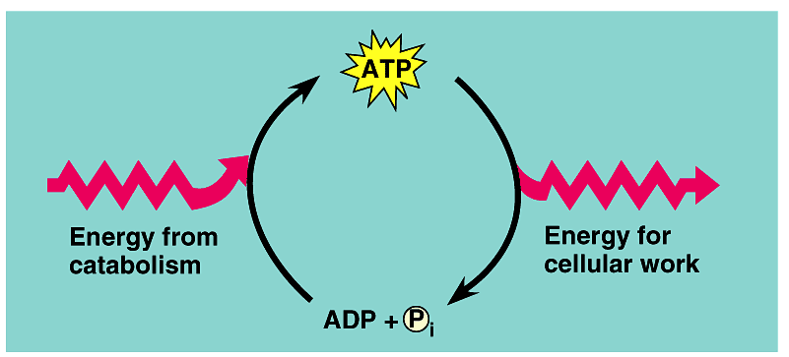
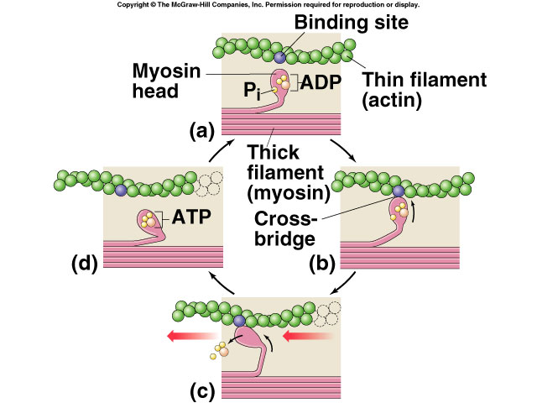
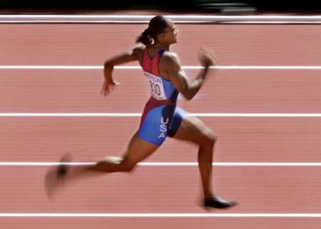
Where is ATP needed?
binding site
thin filament (actin)
myosin head
ADP
thick filament (myosin)
1
2
ATP
So that’s where those 10,000,000 ATPs go!
Well, not all of it!
form cross bridge
1
1
1
3
release cross bridge
shorten sarcomere
Cleaving ATP → ADP allows myosin head to bind to actin filament
1
4

Slide 16
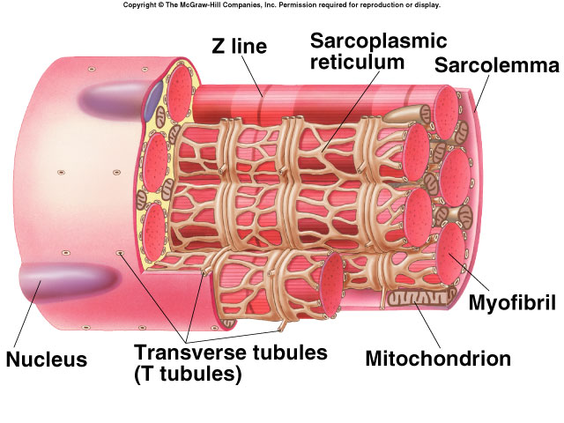
Closer look at muscle cell
Sarcoplasmic reticulum
Transverse tubules (T-tubules)
Mitochondrion
multi-nucleated

Slide 17
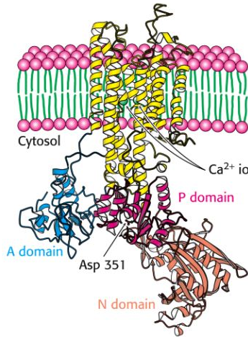
Muscle cell organelles
Ca²⁺ ATPase of SR
Sarcoplasm
muscle cell cytoplasm
contains many mitochondria
Sarcoplasmic reticulum (SR)
organelle similar to ER
network of tubes
stores Ca²⁺
Ca²⁺ released from SR through channels
Ca²⁺ restored to SR by Ca²⁺ pumps
pump Ca²⁺ from cytosol
pumps use ATP
There’s the rest of the ATPs!
But what does the Ca²⁺ do?
ATP

Slide 18
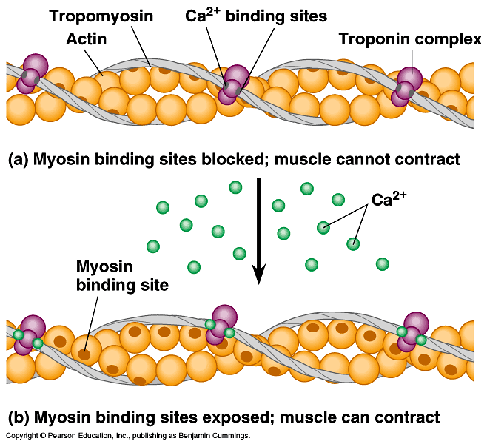
Muscle at rest
Interacting proteins
at rest, troponin molecules hold tropomyosin fibers so that they cover the myosin-binding sites on actin
troponin has Ca²⁺ binding sites

Slide 19
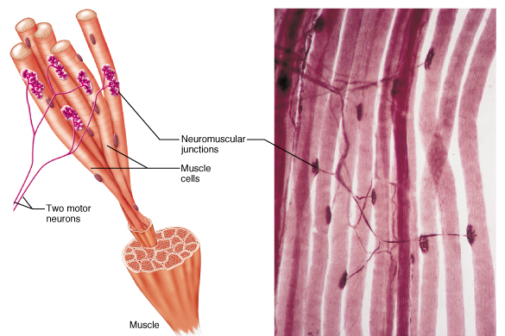
The Trigger: motor neurons
Motor neuron triggers muscle contraction
release acetylcholine (Ach) neurotransmitter

Slide 20
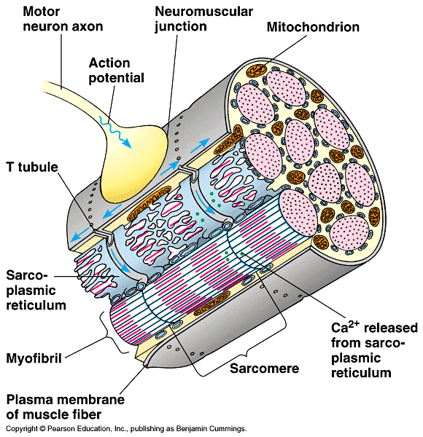
Nerve trigger of muscle action
Nerve signal travels down T-tubule
stimulates sarcoplasmic reticulum (SR) of muscle cell to release stored Ca²⁺
flooding muscle fibers with Ca²⁺

Slide 21
Ca²⁺ triggers muscle action
At rest, tropomyosin blocks myosin-binding sites on actin
secured by troponin
Ca²⁺ binds to troponin
shape change causes movement of troponin
releasing tropomyosin
exposes myosin-binding sites on actin

Slide 22
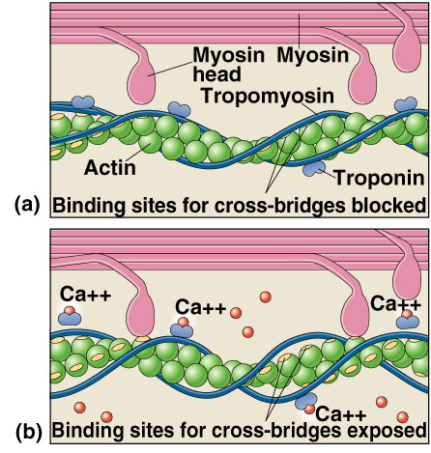
How Ca²⁺ controls muscle
Sliding filament model
exposed actin binds to myosin
fibers slide past each other
ratchet system
shorten muscle cell
muscle contraction
muscle doesn’t relax until Ca²⁺ is pumped back into SR
requires ATP
ATP
ATP

Slide 23
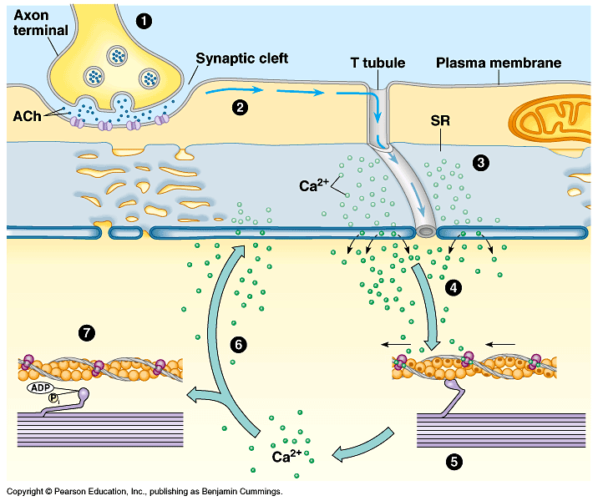
Put it all together…
1
2
3
ATP
7
4
6
ATP
5

Slide 24
How it all works…
Action potential causes Ca²⁺ release from SR
Ca²⁺ binds to troponin
Troponin moves tropomyosin uncovering myosin binding site on actin
Myosin binds actin
uses ATP to "ratchet" each time
releases, "unratchets" & binds to next actin
Myosin pulls actin chain along
Sarcomere shortens
Z discs move closer together
Whole fiber shortens → contraction!
Ca²⁺ pumps restore Ca²⁺ to SR → relaxation!
pumps use ATP
ATP
ATP

Slide 25
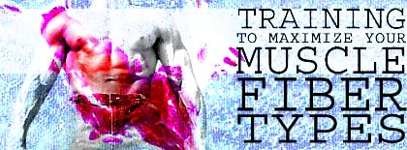
Fast twitch & slow twitch muscles
Slow twitch muscle fibers
contract slowly, but keep going for a long time
more mitochondria for aerobic respiration
less SR → Ca²⁺ remains in cytosol longer
long distance runner
“dark” meat = more blood vessels
Fast twitch muscle fibers
contract quickly, but get tired rapidly
store more glycogen for anaerobic respiration
sprinter
“white” meat

Slide 26
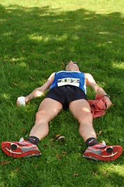
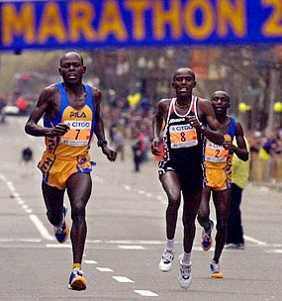
Muscle limits
Muscle fatigue
lack of sugar
lack of ATP to restore Ca²⁺ gradient
low O₂
lactic acid drops pH which interferes with protein function
synaptic fatigue
loss of acetylcholine
Muscle cramps
build up of lactic acid
ATP depletion
ion imbalance
massage or stretching increases circulation

Slide 27
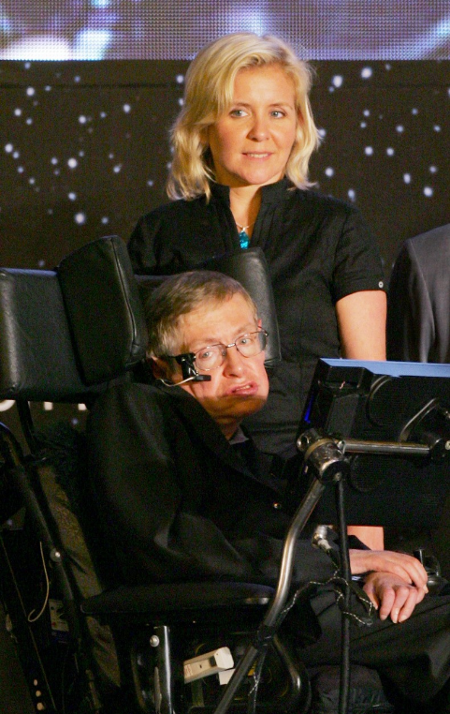

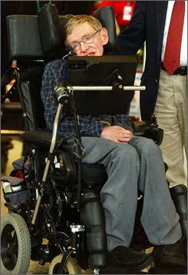
Diseases of Muscle tissue
Stephen Hawking
ALS
amyotrophic lateral sclerosis
Lou Gehrig’s disease
motor neurons degenerate
Myasthenia gravis
auto-immune
antibodies to acetylcholine receptors

Slide 28
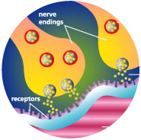
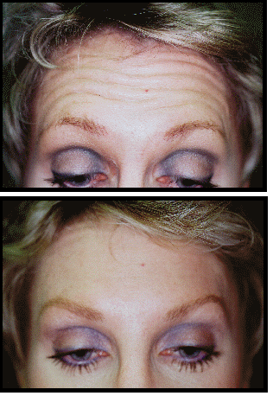
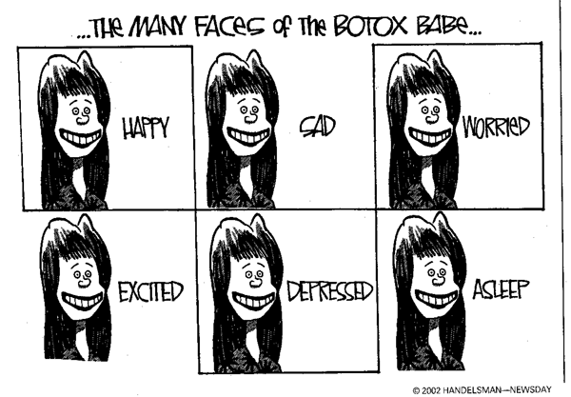
Botox
Bacteria Clostridium botulinum toxin
blocks release of acetylcholine
botulism can be fatal
muscle

Slide 29

Rigor mortis
So why are dead people “stiffs”?
no life, no breathing
no breathing, no O₂
no O₂, no aerobic respiration
no aerobic respiration, no ATP
no ATP, no Ca²⁺ pumps
Ca²⁺ stays in muscle cytoplasm
muscle fibers continually contract
tetany or rigor mortis
eventually tissues breakdown & relax
measure of time of death

Slide 30

能有猶豫,也是一種幸福 猶豫是獲得了“選擇的自由”
Just in Time
Just for Me
Just Enough

Slide 31
Sliding Filament theory
Boat = Myosin (thick filament)
Oar = Myosin side arm
Water = Actin (thin filament)
Life ring = Calcium

Slide 32
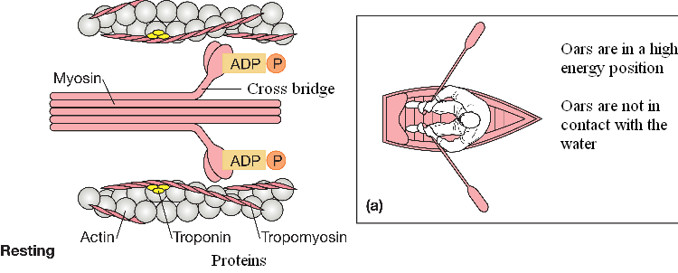
Resting
ATP is bound to myosin side arm.
ATP cleaves into ADP + P (high energy)

Slide 33
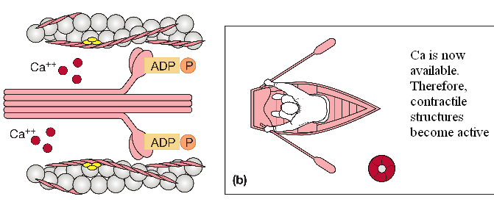
Step 1 Action potential
A nerve action potential releases acetylcholine into the synaptic cleft opening the Na+ channels.
Action potential spreads across sarcolemma releasing Ca into sarcoplasma

Slide 34
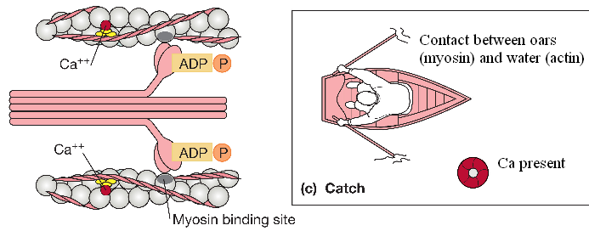
Step 2 Myosin-actin binding
Ca binds to troponin.
A shape change in troponin moves tropomyocin out of the way of actin binding site.
Actin and myosin bind using energy from cleaved ATP.

Slide 35
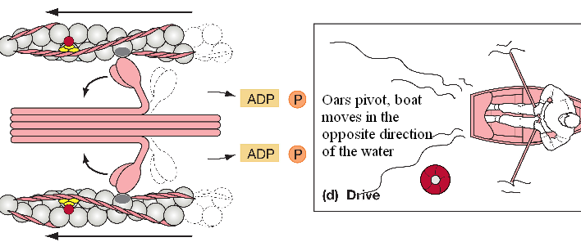
Step 3 Power Stroke
Side arm pivots so myosin and actin slide by each other shortening the sarcomere.
ADP and P released (low energy)

Slide 36
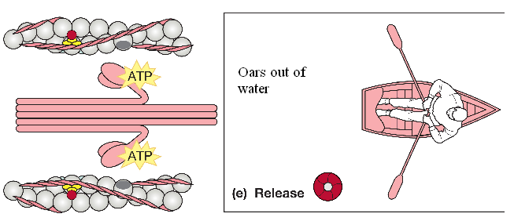
Step 4 ATP Binding Actin-myosin release
A different ATP molecule binds to active site.
Actin released

Slide 37
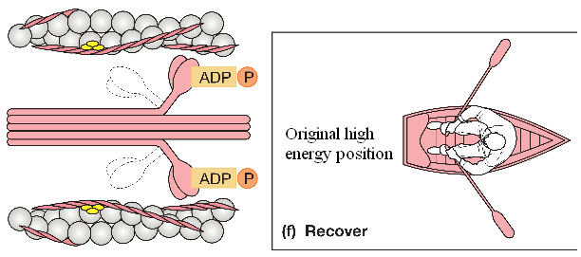
Step 5 ATP cleavage
Return to high energy state
Cycle will repeat if Ca still available.

Slide 38
Think it over
The boat (myosin) does not move far in one cycle, can a muscle contraction occur with one cycle?
No
If a muscle is contracted what happens if a new molecule of ATP is not available?
Muscle stays contracted- cramps
Why does rigor mortis occur? (Hint: What chemical is no longer available to the body?)
ATP is not available to control Ca release so contractions are continuous 6-8 hours after death. Body relaxes 16-24 hours as enzymes break down contractile structures.
Myofilament Contraction

Slide 39
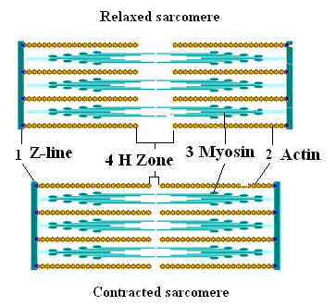
Sarcomere summary

Slide 40
Sliding Filament Theory
Focus questions:
What happens to the length of the sarcomere during a contraction?
The sarcomere shortens.

Slide 41
能有猶豫,也是一種幸福 猶豫是獲得了“選擇的自由”
Just in Time
Just for Me
Just Enough

Slide 42
THE MUSCULAR SYSTEM

Slide 43
Interactions of Skeletal Muscle
Agonist=prime mover
Antagonist=opposes the agonist
Synergist=helpers
Fixators=immobilizers

Slide 44
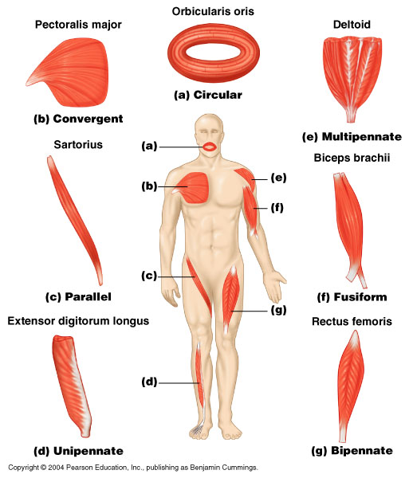
Fascicle Arrangement

Slide 45
Muscle Mechanics
Lever Systems

Slide 46
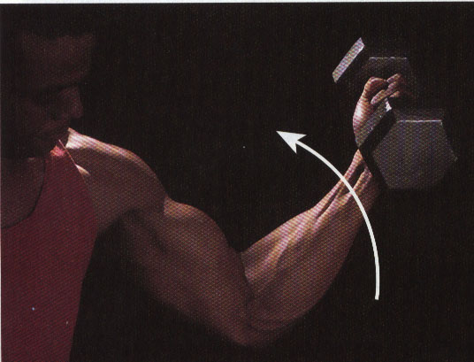
Types of Muscle Contraction
There are two types of muscle contraction.
Isotonic

Slide 47
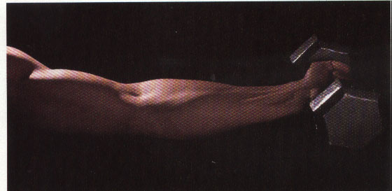
ii. Isometric

Slide 48
What is a Lever?
A lever is a rigid bar that moves on a fixed point, or fulcrum, when a force is applied to it. The applied force, or effort, is used to move a resistance, or load.

Slide 49
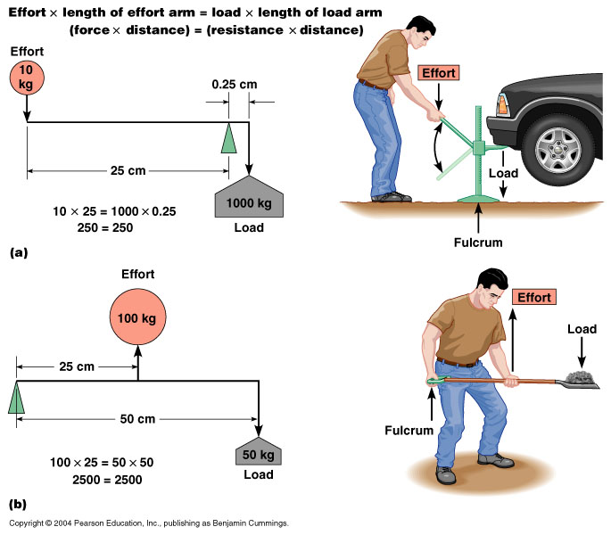
Mechanical Advantage

Slide 50
Mechanical Disadvantage

Slide 51
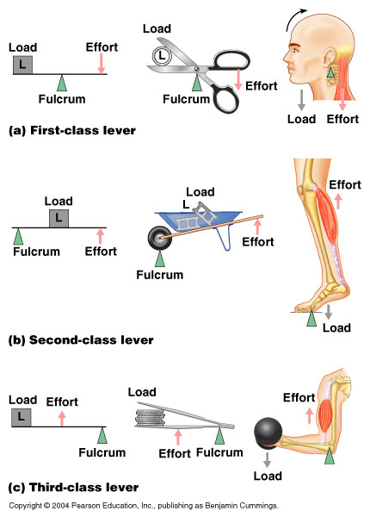
Three Classes of Levers

Slide 52
Three Classes of Levers

Slide 53
Three Classes of Levers

Slide 54
能有猶豫,也是一種幸福 猶豫是獲得了“選擇的自由”
Just in Time
Just for Me
Just Enough

Slide 55
Muscle Mechanics

Slide 56
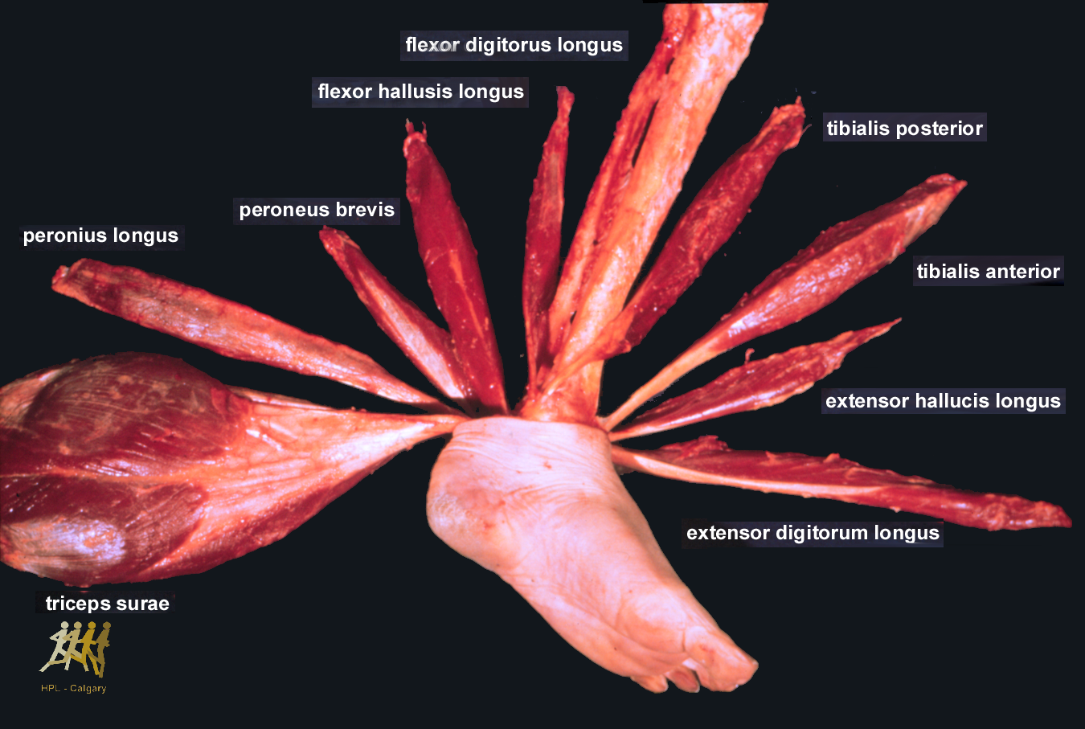
Preparation
Hintermann
flexor digiturum longus
flexor halucis longus
tibialis posterior
peroneus brevis
peroneus longus
tibialis anterior
ext. hallucis longus
ext. digitorum longus
triceps surea
Muscles crossing the ankle joint complex

Slide 57
Muscle Schematic Illustration
muscle
fascia
fascicle
epimysium
muscle fibre (cell)
perimysium
myofibril
sacrolemma
endomysium

Slide 58
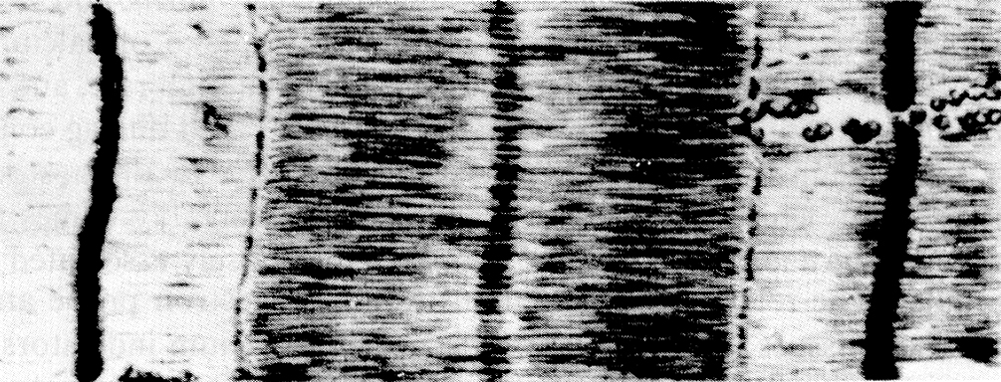
Myofibril
Huxley and Huxley, 1954
I - Band
A - Band
Z Line
M Line

Slide 59

Myofibril
sarcomere
I-band
A-band
filament
Z-line

Slide 60
Cross bridge theory
Current paradigm to describe muscle contraction
Hugh Huxley and Andrew Huxley published in 1954 two independent papers (which were basically identical) to describe the sliding of the thick and thin filaments past one another.
 sliding filament theory
Refinished in 1957 by A. Huxley  cross bridge theory

Slide 61
Cross bridge theory
thick filament
thin filament
Z-line
Z-line
I-Band
A-Band

Slide 62
thick myofilament
thin myofilament

Slide 63

Huxley and Huxley, 1954
I - Band
A - Band
Z Line
M Line
Sliding filament model
Z
A
I
M
1μm
thick filaments
thin filaments

Slide 64
Cross bridges
globular head
tail portion
myosin molecule
thick myofilament

Slide 65
Cross bridges
60º
14.3 nm
43 nm

Slide 66
Cross bridge theory
rest
cross-bridge
thin filament
thick filament
contraction
sliding

Slide 67
Muscle Force Depends on Four Factors
Sarcomere (muscle) length
Velocity of muscle contraction
Activation level
Previous contraction history

Slide 68
Force-Length Relationship
Fact:
Muscles at very long and very short lengths can not produce high forces
Fact:
Maximal force production of a muscle depends on its length

Slide 69
Force-Length Relationship
Force [%]
plateau region
100
75
50
ascending limb
descending limb
25
0
Sarcomere length

Slide 70
Force-Length Relationship
Sarcomere = 1 z-line + 2 thin filament + 1 thick filament - overlaps
0.10 μm
0.95 μm
1.60 μm

Slide 71
Force-Length Relationship

Slide 72
Force-Length Relationship
a
b
a
100
75
tension generated
50
b
25
c
0
1.5 2.0 2.5 3.0 3.5
sarcomere length [μm]
c

Slide 73
能有猶豫,也是一種幸福 猶豫是獲得了“選擇的自由”
Just in Time
Just for Me
Just Enough

Slide 74
Biomechanics of Skeletal Muscle

Slide 75
Contents
I. Composition & structure of skeletal muscle
II. Mechanics of Muscle Contraction
III. Force production in muscle
IV. Muscle remodeling
V. Summary

Slide 76
Muscle types:
cardiac muscle: composes the heart
smooth muscle: lines hollow internal organs
skeletal (striated or voluntary) muscle: attached to skeleton via tendon & movement
Skeletal muscle 40-45% of body weight
> 430 muscles
~ 80 pairs produce vigorous movement
Dynamic & static work
Dynamic: locomotion & positioning of segments
Static: maintains body posture

Slide 77
I. Composition & structure of skeletal muscle
Structure & organization
Muscle fiber: long cylindrical multi-nuclei cell 10-100 μm
fiber →endomysium → fascicles → perimysium →
epimysium (fascia)
Collagen fibers in perimysium & epimysium are continuous
with those in tendons
{thin filament (actin 5nm) + thick filament (myosin 15 nm)}
→ myofibrils (contractile elements, 1μm) →muscle fiber

Slide 78


Slide 79


Slide 80

Bands of myofibrils
A bands: thick filaments in central of sarcomere
Z line: short elements that links thin filaments
I bands: thin filaments not overlap with thick filaments
H zone: gap between ends of thin filaments in center of A band
M line: transverse & longitudinally oriented linking proteins for adjacent thick filaments
A band
H
I band
Z
M
Z
sarcomere

Slide 81

Sarcoplasmic reticulum
network of tubules & sacs;
parallel to myofibrils
enlarged & fused at junction between A & I bands: transverse sacs (terminal cisternae)
Triad {terminal cisternae, transverse tubule}
T system: duct for fluids & propogation of electrical stimulus for contraction (action potential)
Sarcoplasmic reticulum store calcium

Slide 82

Molecular composition of myofibril
Myosin composed of individual molecules each has a globular head and tail
Cross-bridge: actin & myosin overlap (A band)
Actin has double helix; two strands of beads spiraling around each other
troponin & tropomysin regulate making and breaking contact between actin & myosin

Slide 83

Molecular basis of muscle contraction
Sliding filament theory: relative movement of actin & myosin filaments yields active sarcomere shortening
Myosin heads or cross-bridges generate contraction force
Sliding of actin filaments toward center of sarcomere: decrease in I band and decrease in H zone as Z lines move closer

Slide 84



Neuro-Muscular Junction (NMJ)

Slide 85


Slide 86

ATP
ATP

Slide 87

Histology of muscle
Type IIA
Type IIB
Type I
Eye muscle (Rectus lateralis); Myofibrillar ATPase stain, PH 4.3

Slide 88
Muscle Differentiation (types of fibers)
 | I (slow-twitch oxidative) | IIA (fast-twitch oxidative glycolytic) | IIB fast-twitch glycolytic
Contraction speed | Slow | fast | fast
Myosin-ATPase activity | Low | High | High
Primary source of ATP production | Oxidative phosphorylation | Oxidative phosphorylation | Anaerobic glycolysis
Glycolytic enzyme activity | Low | Intermediate | High
No. of mitochondria | Many | Many | Few
Capillaries | Many | Many | Few
Myoglobin contents | High | High | Low
Muscle Color | Red | Red | White
Glycogen content | Low | Intermediate | High
Fiber diameter | small | Intermediate | Large
Rate of fatigue | slow | Intermediate | Fast

Slide 89

Functional arrangement of muscle
α pinnated angle of muscle

Slide 90

The Musculotendinous Unit
Tendon- spring-like elastic component in series with contractile component (proteins)
Parallel elastic component (epimysium, perimysium, endomysium, sarcolemma)
F
x
PEC: parallel elastic component
CC: contractile component
SEC: series elastic component

Slide 91
II. Mechanics of Muscle Contraction
Neural stimulation – impulse
Mechanical response of a motor unit - twitch
T: twitch or contraction time, time for tension to reach maximum
F₀: constant of a given motor unit
Averaged T values
Tricep brachii 44.5 ms Soleus 74.0 ms
Biceps brachii 52.0 ms Medial Gastrocnemius 79.0 ms
Tibialis anterior 58.0 ms

Slide 92



Summation and tetanic contraction
(ms)

Slide 93

Generation of muscle tetanus
100Hz
10 Hz
Note: muscle is controlled by frequency modulation from neural input very important in functional electrical stimulation

Slide 94

Wave summation & tantalization
Critical frequency

Slide 95

Motor unit recruitment
All-or-nothing event
2 ways to increase tension:
- Stimulation rate
Recruitment of more motor unit
Size principle
Smallest m.u. recruited first
Largest m.u. last

Slide 96
III. Force production in muscle
Force –length characteristics
Force – velocity characteristics
Muscle Modeling
Neuromuscular system dynamics

Slide 97

1 Force-length curve of contractile component
Resting 2.0-2.25 um max. no. of cross bridges; max. tension
2.25-3.6 um no. of cross bridge ↓
< 1.65 um overlap of actin no. of cross bridge ↓

Slide 98

Influence of parallel elastic component
F_{c}
F_{t}
F_{t}
F_{p}
F_{p}
l₀
F_{c}
l₀
Note: F_{c} is under voluntary control & F_{p} is always present

Slide 99

Overall force-length characteristics of a muscle

Slide 100

Series Elastic Component
Tendon & other series tissue
Lengthen slightly in isometric contraction
Series component can store energy when stretched prior to an explosive shortening

Slide 101

Quick-release for determining elastic constant of series component
F
Muscle is stimulated to build tension
Release mechanism is activated
Measure instantaneous shortening x while force is kept constant
Contractile element length kept constant during quick release

Slide 102
In vivo force-length measurement
Human in vivo experiments (MVC)
Challenges:
Impossible to generate a max. voluntary contraction for a single agonist without activating remaining agonist
Only moment & angle are measurable. Moment depends on muscle force and moment arm.

Slide 103
2 Force-Velocity Characteristics
Concentric contraction
Muscle contracts and shortening, positive work was done on external load by muscle
Tension in a muscle decreases as it shortens
Eccentric contraction
Muscle contracts and lengthening, external load does work on muscle or negative work done by muscle.
Tension in a muscle increases as it lengthens by external load

Slide 104

Force-velocity characteristics of skeletal muscle (Hill model)
eccentric
concentric
F
v
Increased tensions in eccentric due to:
Cross bridge breaking force > holding force at isometric length
High tendon force to overcome internal damping friction

Slide 105

Length and velocity versus Force
Note: maximum contraction condition; normal contractions are fraction of the maximum force

Slide 106

Equilibrium of load and muscle force
Muscle force is function of length, velocity and activation
The load determines activation and length of muscle by the equilibrium condition
Load: spring-like, inertial, viscous damper
Nonlinear
spring
linear
spring

Slide 107

3 Muscle Modeling
Elements of Hill model other than contractile element

Slide 108

Derive equations of motion
Estimated parameters based on
Experimental data & model
Simulation (least squares)
. Numerical simulation

Slide 109
4 Neuromuscular system dynamics
Muscle force
F = F₀ * Act * F_{LT} * F_{FV}
T = r(θ) * F(L(θ), V, A)
F₀= F₀(pinnated angle, PCSA, fiber type)
Max torque due to each muscle
20
15
10
brachialis
biceps, long
biceps, short
5
brachioradialis
Torque (N-m)
0
passive
-5
triceps, med.
triceps, lat.
muscle
r
-10
-15
triceps, long
0
0.5
1
1.5
2
2.5
Angle (radian)
Note: feedback mechanism in neuromuscular system

Slide 110
Neuromuscular system modeling
tendon
+
-
Muscle-Tendon
Length
Tendon
Compliance
Central
Command
& reflexes
muscle
Activation
Dynamics
Contraction
Dynamics
Force
Muscle-Tendon
Velocity
Tendon
Compliance
+
-
tendon

Slide 111

Muscle fatigue
Drop in tension followed prolonged stimulation.
Fatigue occurs when the stimulation frequency outstrips rate of replacement of ATP, the twitch force decreases with time

Slide 112
V. Muscle Remodeling
Effects of Disuse and Immobilization
Immediate or early motion may prevent muscle atrophy after injury or surgery
Muscle fibers regenerate in more parallel orientation, capillariaztion occurred rapidly, tensile strength returned more quickly
Atrophy of quadriceps developed due to immobilization can not be reversed by isometric exercises.
Type I fibers atrophy with immobilization; cross-sectional area decreases & oxidative enzyme activity reduced
Tension in muscle afferent impulses from intrafusal muscle spindle increases & leading to increase stimulation of type I fiber

Slide 113
Effects of Physical Training
Increase cross-sectional area of muscle fibers, muscle bulk & strength
Relative percentage of fiber types also changes
In endurance athletes % type I, IIA increase
Stretch out of muscle-tendon complex increases elasticity & length of musculo-tendon unit; store more energy in viscoelastic & contractile components
Roles of muscle spindle & Golgi tendon organs: inhibition of spindle effect & enhance Golgi effect to relax muscle and promote further lengthening.

Slide 114
V. Summary
Structure unit of muscle: fiber
Myofibrils are composed of actin & myosin
Sliding filament theory & cross-bridge
Calcium ion & contractivity
Motor unit: a single neuron & all muscle fibers innervated by it
Force production depends on length, velocity, muscle composition & morphology (Hill model)

Slide 115





The real goal however…….
is to avoid ….

Slide 116




正確詮釋問題，
往往比找到正確答案來得重要。

Slide 117

How can I help?
「我能夠幫什麼？」是所有良好關係的基礎。

Slide 118


For what I was trying to say and to do was to make my professional life focused on the three C’s - competence, caring, and compassion - and to make my very private personal life dedicated to family - to you all.
For your support, caring and love
During these challenging years
And always.

Slide 119
能有猶豫,也是一種幸福 猶豫是獲得了“選擇的自由”
Thank You
Just in Time
Just for Me
Just Enough

